Slide 1
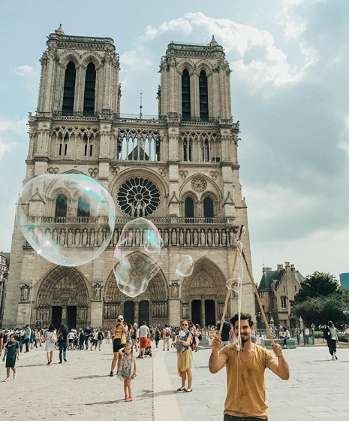


TOURISM
GRACE CHAN
ISABEL BUECHSEL

Slide 2

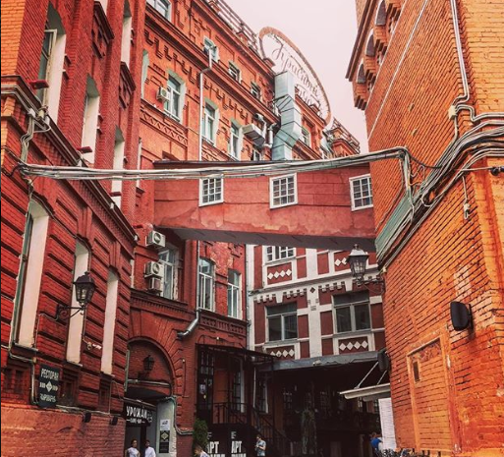
EXPLORING
ARRIVALS
DEPARTURES
TOURISM EXPENDITURE IN COUTRY
TOURISM EXPENDITURE IN OTHER COUNTRY
BY COUNTRY
USING UN DATA

Slide 3

TOP 15
TOTAL ARRIVALS
FRANCE
USA
SPAIN
CHINA
ITALY
HONG KONG
RUSSIA
UK
GERMANY
MEXICO
TURKEY
AUSTRIA
CANADA
MALAYSIA
POLAND
TOP 15
TOTAL DEPARTURES
HONG KONG
USA
GERMANY
UK
POLAND
CHINA
RUSSIA
ITALY
CANADA
FRANCE
HUNGARY
JAPAN
NETHERLANDS
UKRAINE
MALAYSIA

Slide 4
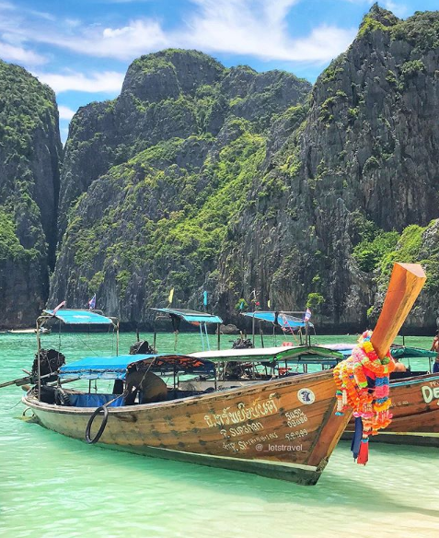
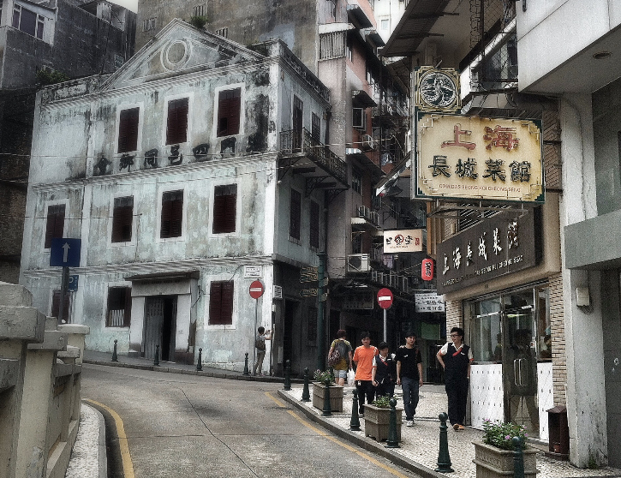
TOP 15
TOURISM EXPENDITURE IN COUNTRY – US $M
USA
FRANCE
GERMANY
UK
ITALY
AUSTRALIA
THAILAND
SPAIN
HONG KONG
MACAO
CANADA
TURKEY
SWITZERLAND
GREECE
MEXICO
WHILE AUSTRALIA, THAILAND, MACAO, SWITZERLAND, AND GREECE DID NOT MAKE THE LIST OF TOP 15 COUNTRIES TRAVELED TO, TOURISTS SPENT MORE IN THOSE COUNTRIES

Slide 5

TOP 15
TOURISM EXPENDITURE IN OTHER COUNTRY – US $M
USA
GERMANY
UK
JAPAN
FRANCE
CANADA
RUSSIA
AUSTRALIA
KOREA
ITALY
SWITZERLAND
BRAZIL
NORWAY
BELGIUM
SAUDI ARABIA
WHILE AUSTRALIA, KOREA, SWITZERLAND, BRAZIL, NORWAY, BELGIUM, AND SAUDI ARABIA DID NOT MAKE THE LIST OF TOP 15 COUNTRIES DEPARTED FROM, TOURISTS FROM THOSE COUNTRIES SPENT MORE IN OTHER COUNTRIES

Slide 6
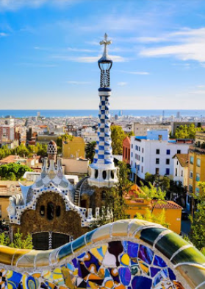
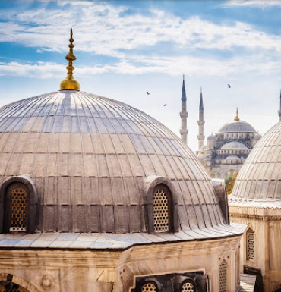
TOP 10 MOST
INSTAGRAMMED CITIES
2017
NEW YORK, US
MOSCOW, RUSSIA
LONDON, UNITED KINGDOM
SAO PAULO, BRAZIL
PARIS, FRANCE
LOS ANGELES, US
ST PETERSBURG, RUSSIA
JAKARTA, INDONESIA
ISTANBUL, TURKEY
BARCELONA, SPAIN

Slide 7
